Slide 1
A Geeks Guide to Cloud Imaging
Johan Arwidmark
Technical Fellow @ 2Pint Software
Twitter @jarwidmark
Email johan@2pintsoftware.com
Microsoft MVP

Slide 2

Tweet Tweet
If you’re not on Twitter, get on Twitter!
Tweet Tweet
Start the online conversation at #SCUGDK and @jarwidmark
Start the online conversation at #NVSummit2021

Slide 4
Deploying Machines Over Internet
Build Scenarios
Imaging from home or at a remote location
Rebuilding infrastructure after ransomware attacks
Windows 10 servicing
Managing machines after deployment
Resetting and refreshing devices

Slide 5
Cloud Imaging Fundamentals
Cloud components / infrastructure
Starting the imaging process
Transferring of content
Monitoring the process

Slide 6
Cloud Infrastructure
MDT in Azure or Amazon
Cloud Management Gateway (Azure only)
Microsoft Intune
Windows Autopilot
Microsoft Graph (automation)

Slide 7
Starting The Deployment
WiFi or Wired connections
USB Sticks (Security considerations, Expire Dates)
Boot directly from BIOS (UEFI)
Boot via Android / iPhone
PXE boot over Internet

Slide 8


Slide 9
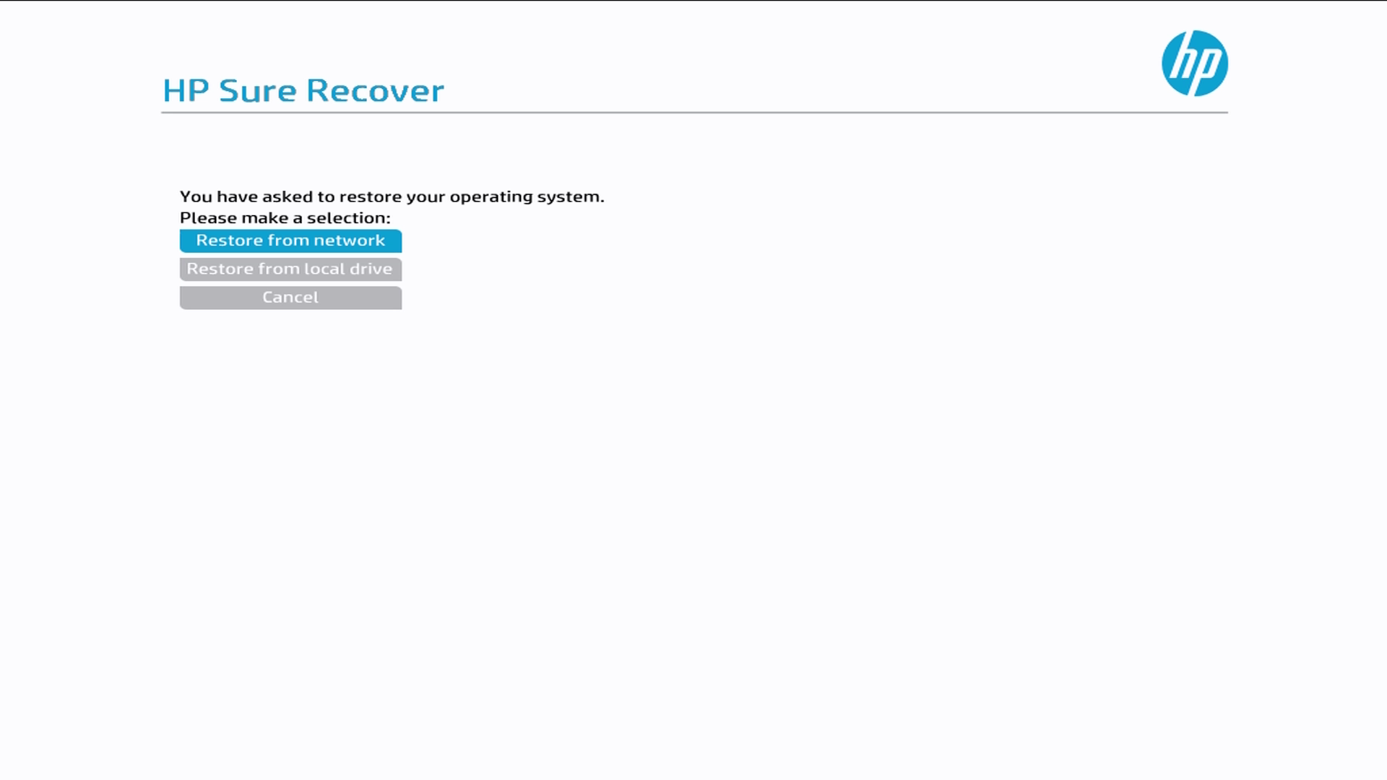

Slide 10
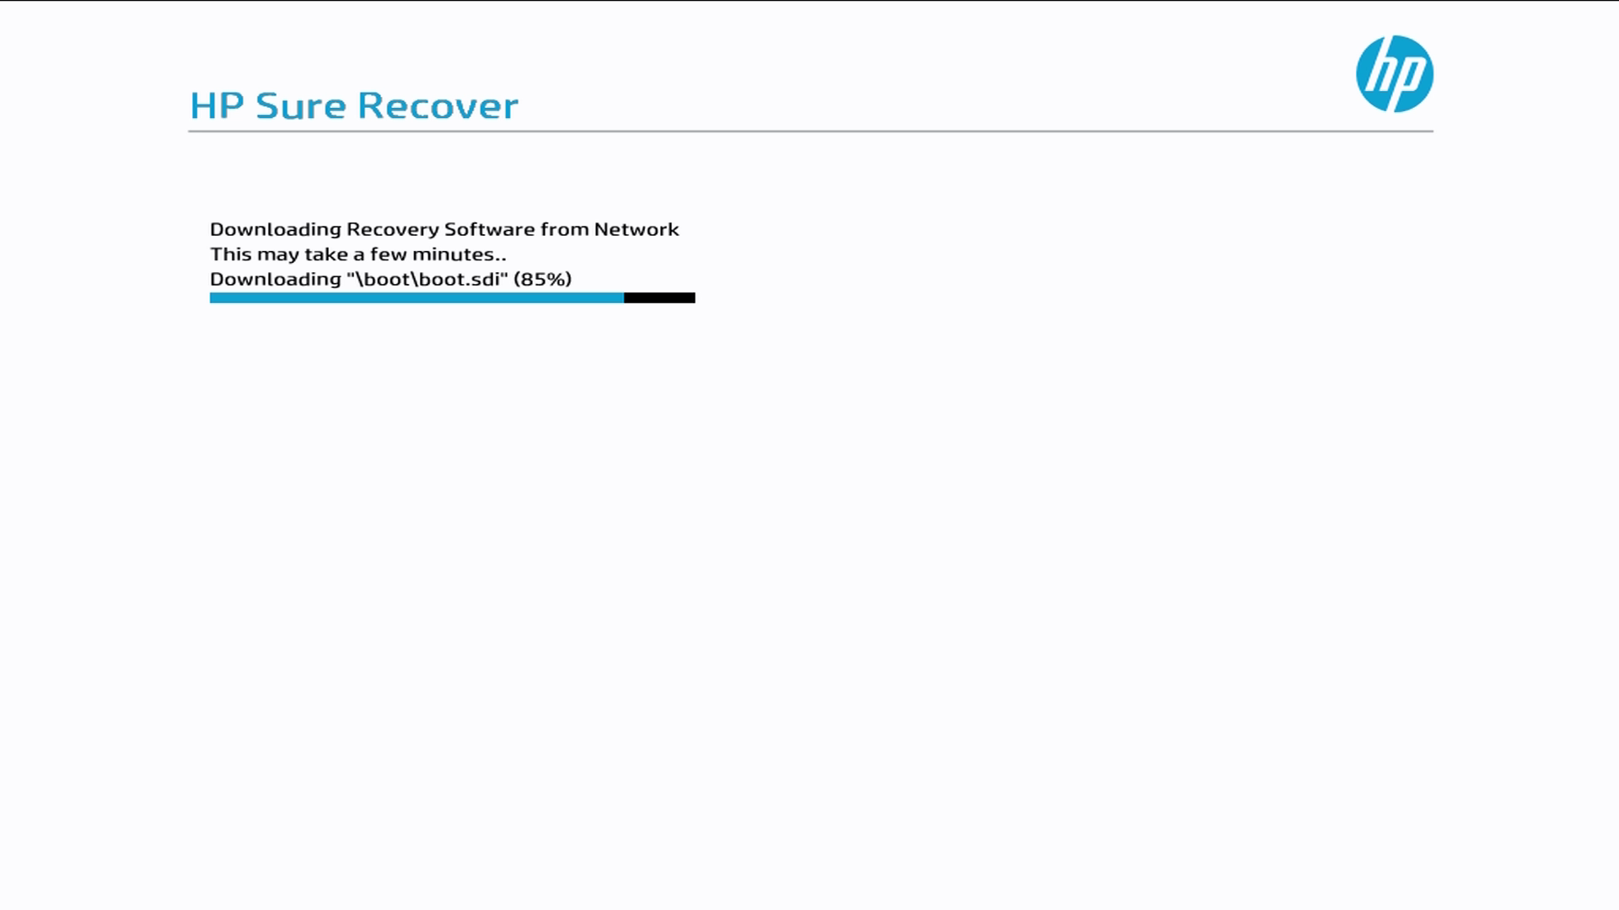

Slide 11
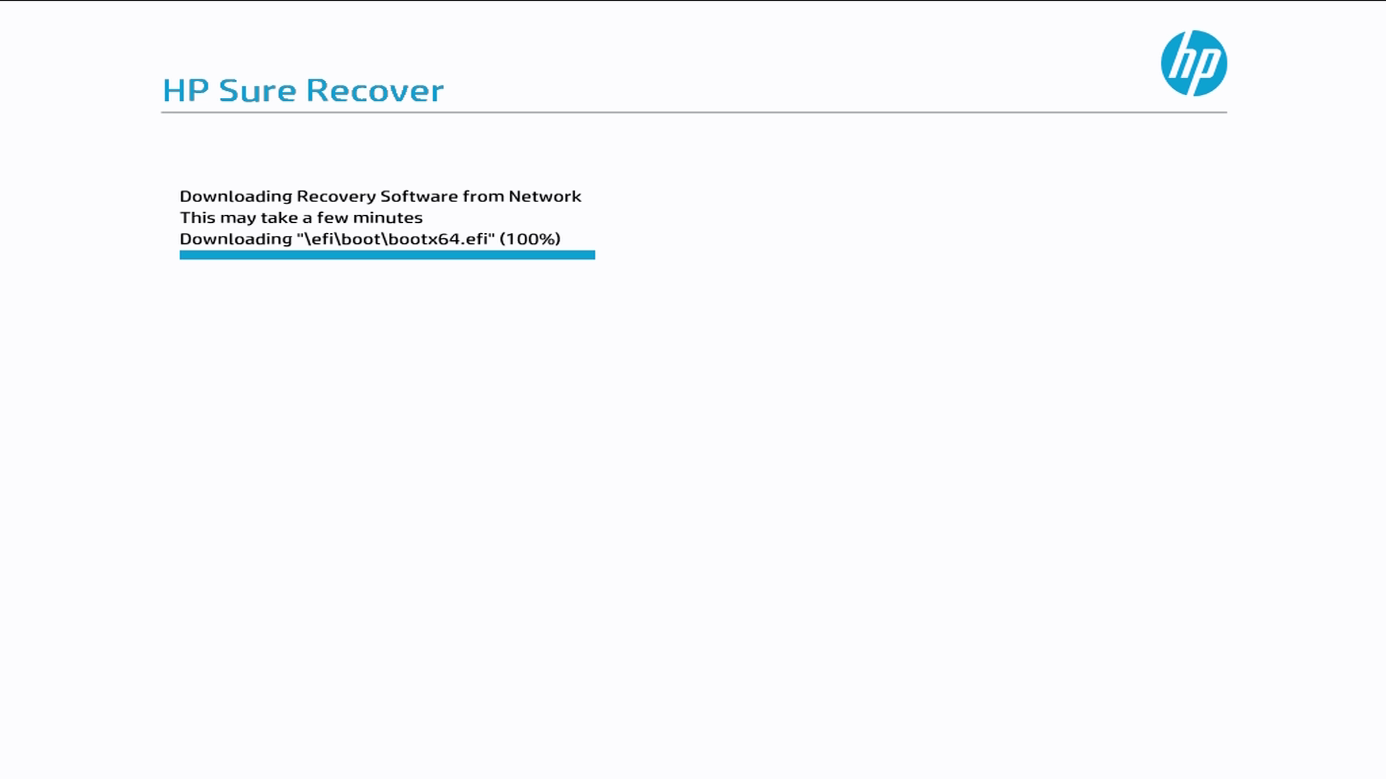

Slide 12
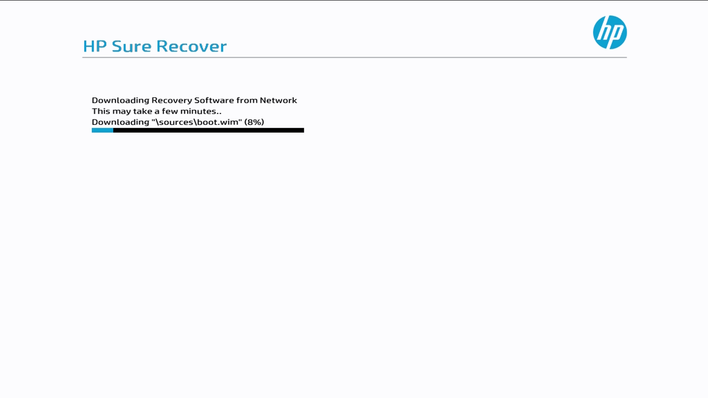

Slide 13


Slide 14
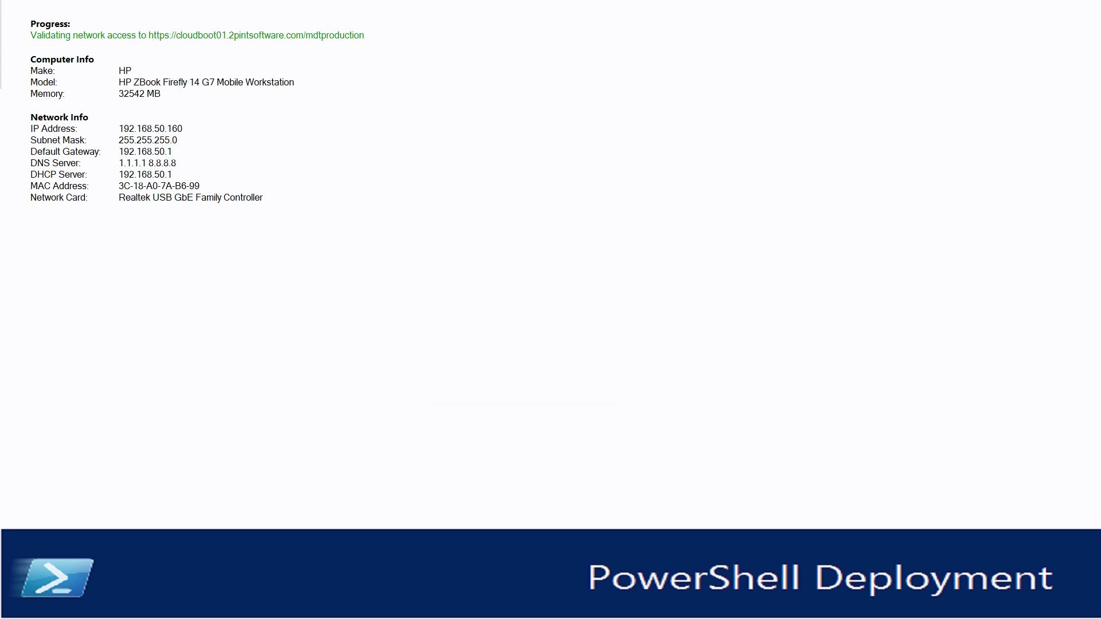

Slide 15
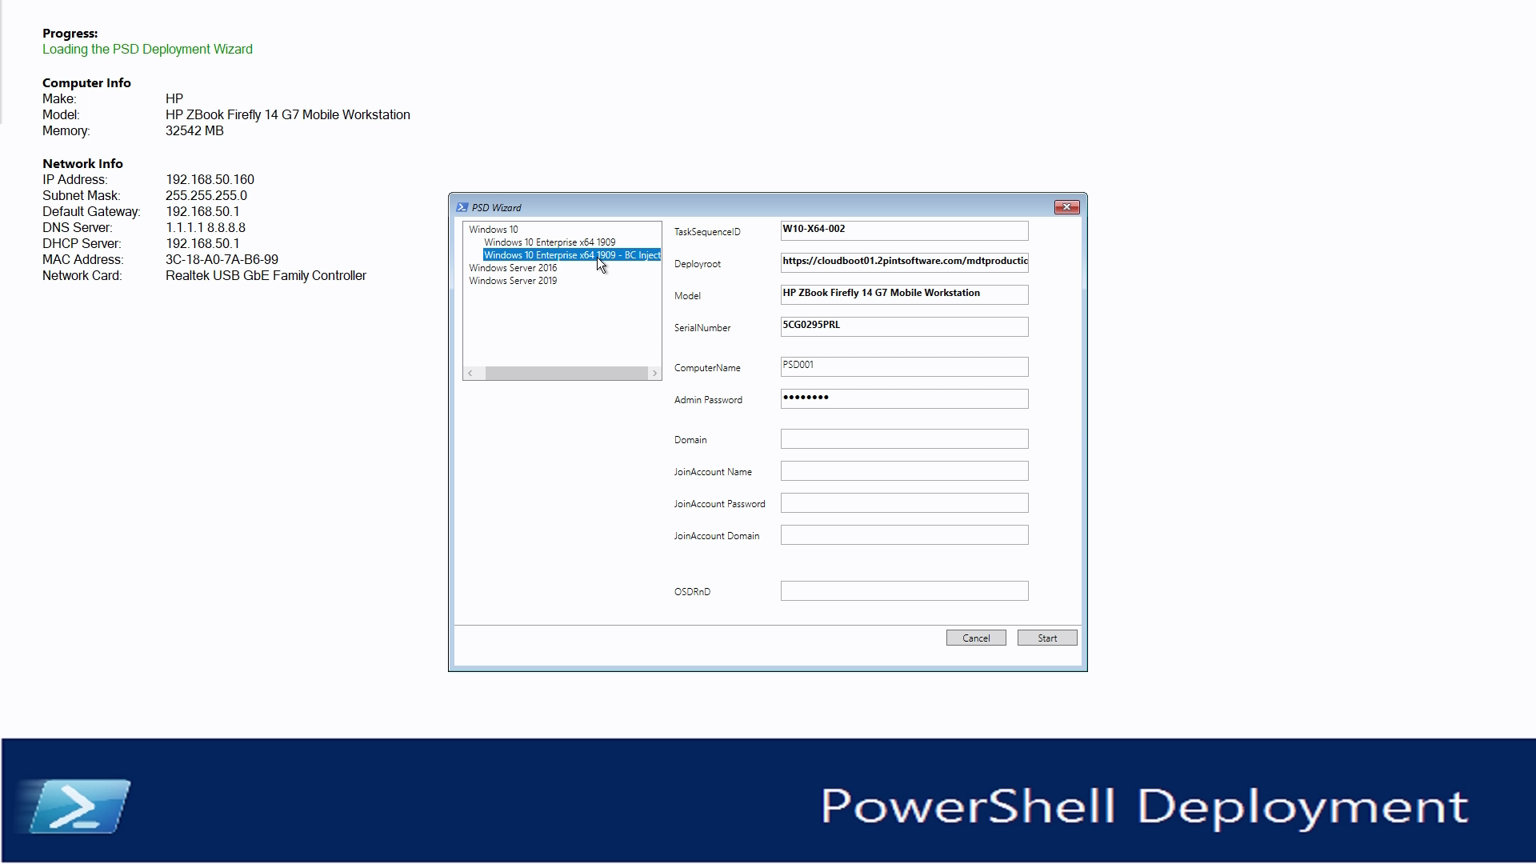

Slide 16
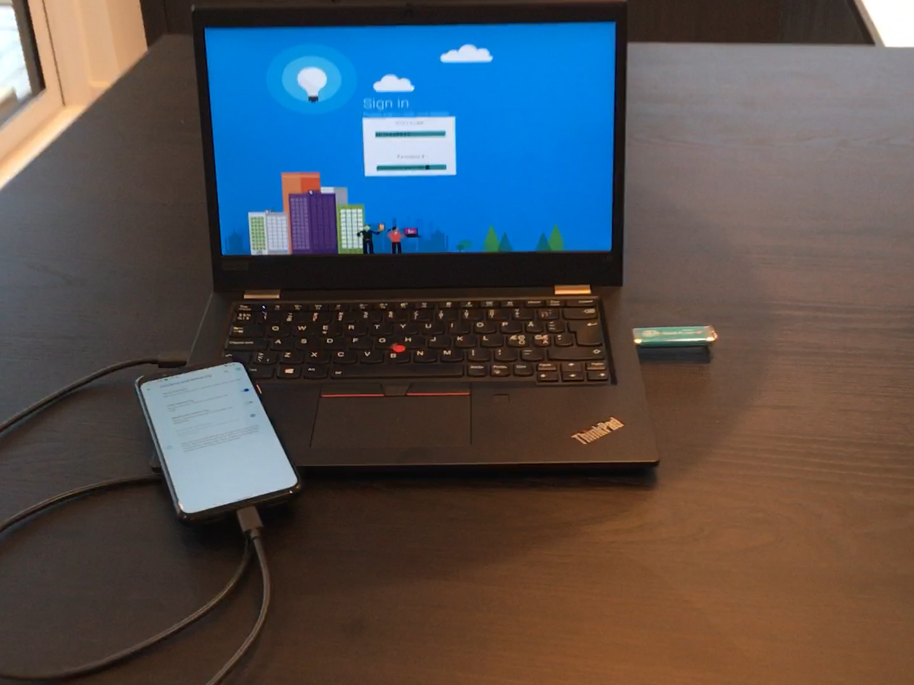

Slide 17
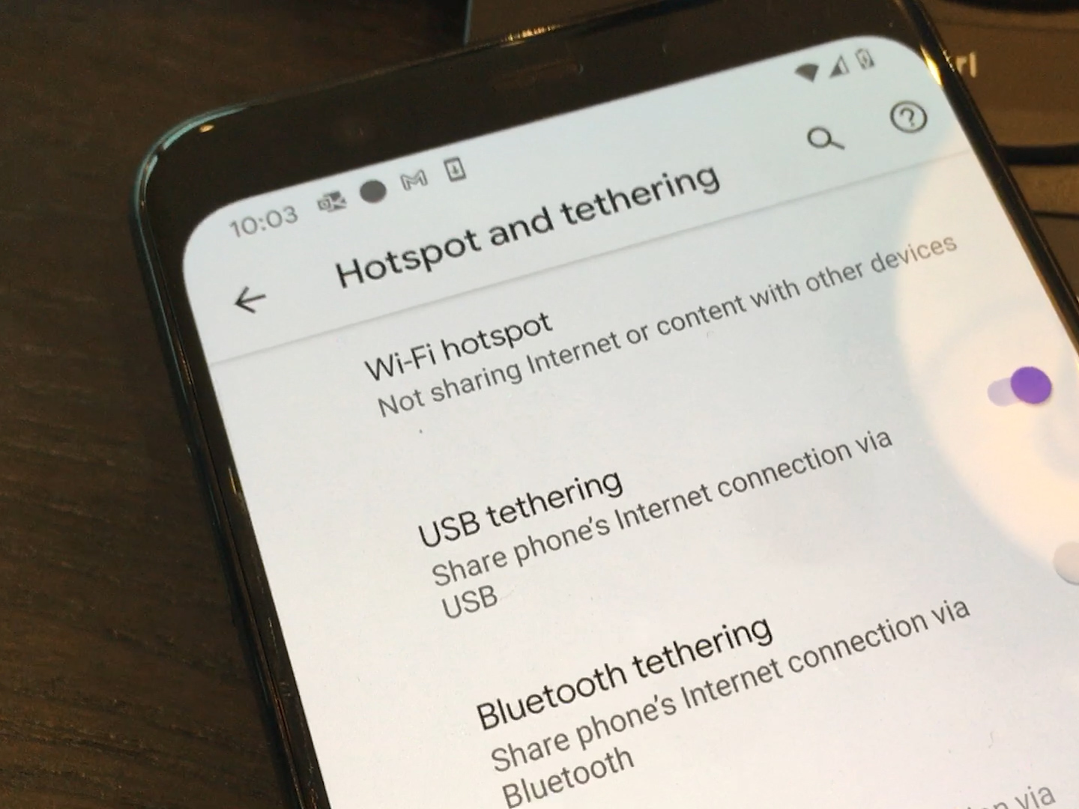

Slide 18
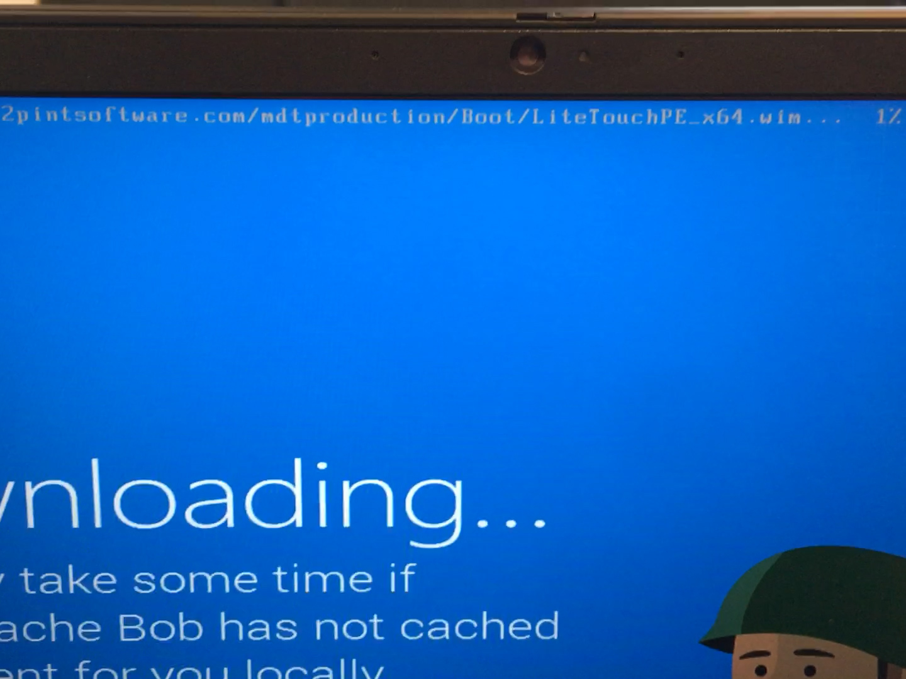

Slide 19
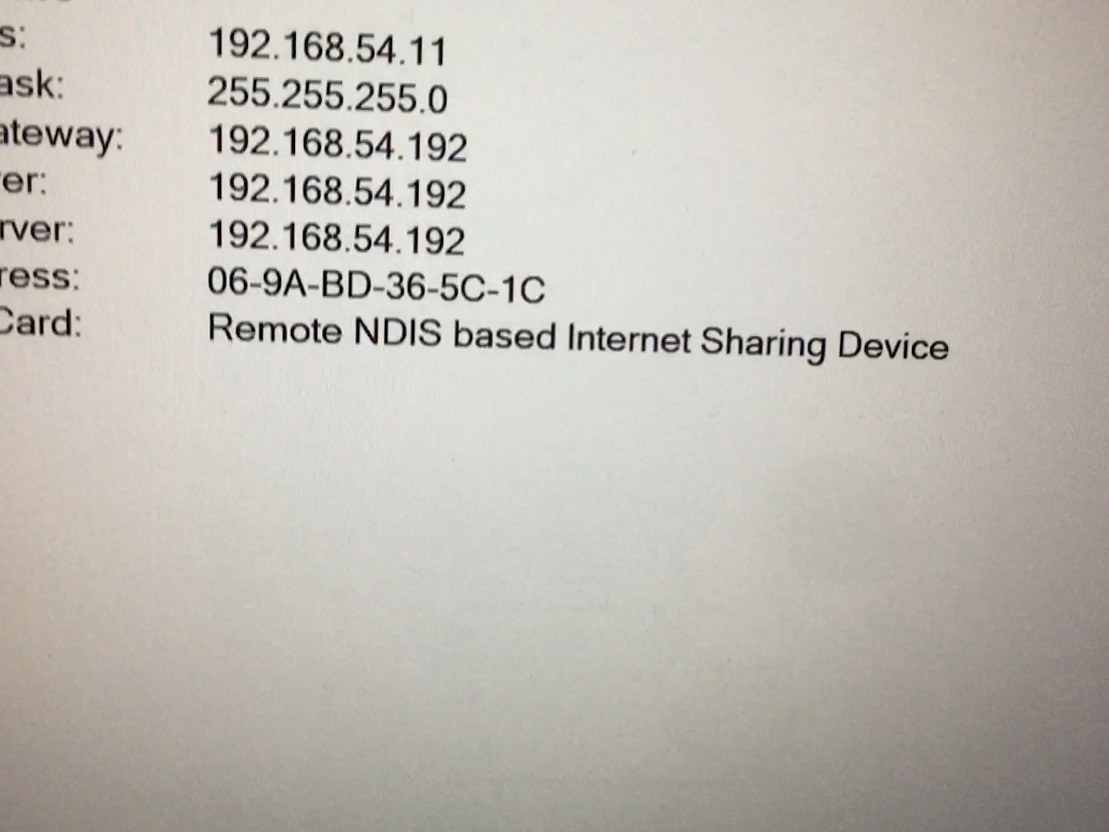

Slide 20
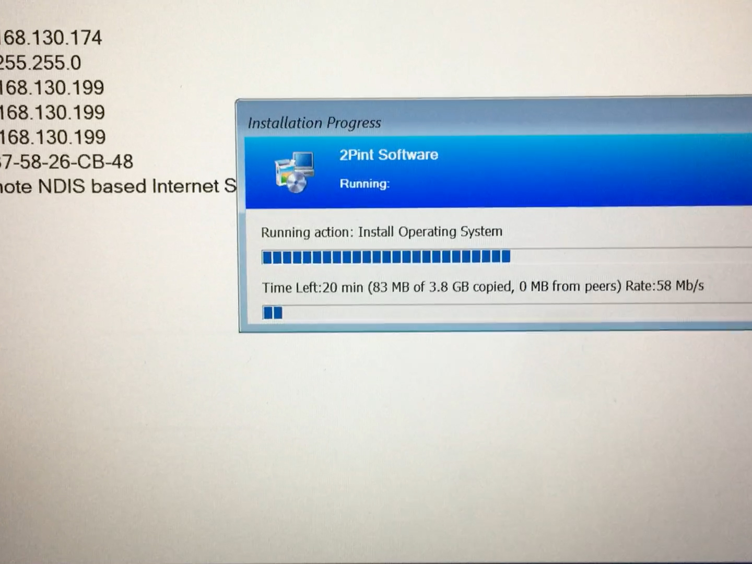

Slide 21
Transferring of content
Speeding up HTTPS Downloads
Archiving drivers and applications
Reducing costs via P2P
BranchCache

Slide 22
Monitoring the process
Local Logging
Server Side Logging (BITS Upload or Azure Blob Upload)
MDT Monitoring Service
Status Message via CMG

Slide 23
ViaMonstra Online Academy
academy.viamonstra.com

Slide 24
Thank you!
MSEndPointMgr.com#MSEndPointMgr
System Center User Group
Finland
#SCUGFI
System Center User Group Denmark
#SCUGDK
System Center User Group Sweden
#SCUGSE
Modern Management User Group Norway
#MMUGNO

